Slide 1
Data
Code
Data

Slide 2
GLFW.h
glad.h
Blah
Our OpenGL.cpp
Blah
Blah
glad.c
GLFW.lib
The OS

Slide 3
Vertices (in a file)
FileLoader
Vertices (in RAM) (from file)
OpenGL.cpp
Vertices (in RAM) (matching shader)
glBufferData
Vertices (into GPU RAM)

Slide 4
Vertices (into GPU RAM)
OpenGL.cpp
Vertex shader
Pixel fragment shader
The screen (framebuffer)

Slide 5
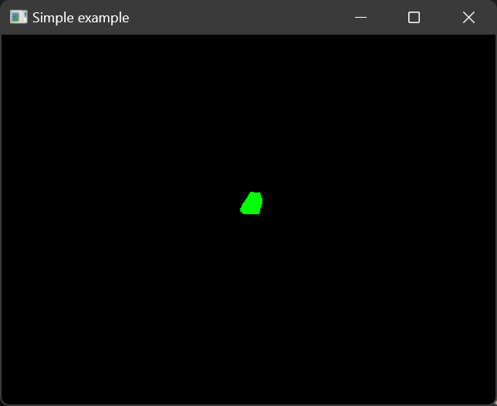
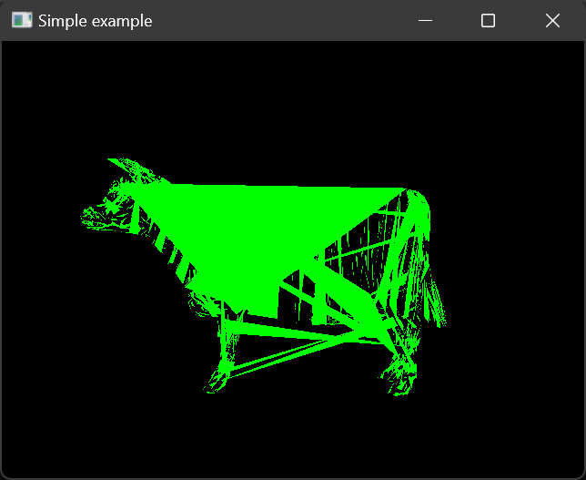

Slide 6
Cow.ply
vertices
Vertex buffer
triangles
Element buffer

Slide 7
Feeney’s copy (origin)
Your local copy

Slide 8
OpenGL libraries, etc.

